Slide 1










ATAI
Advanced Technique of Artificial Intelligence
ATAI
ChongqingUniversity _{AdvancedTechniqueof}
of Technology Artificial Intelligence
Chongqing University of
Technology
Chongqing University ^{ATAI}
_{of Technology} Advanced Techniqueof
Artificial Intelligence
Chongqing University of Technology
Chongqing University of Technology
SPRINT: Scalable and Predictive Intent Refinement for
LLM-Enhanced Session-based Recommendation
Code: https://github.com/Gyu-Seok0/SPRINT_SIGIR26
—— SIGIR_2026
Reported by Yongkang Ding
1
Notes:
Source: SPRINT: Scalable and Predictive Intent Refinement for LLM-Enhanced Session-based Recommendation. SIGIR 2026. DOI: 10.1145/3805712.3809756. Title and author information, p. 1.

Slide 2
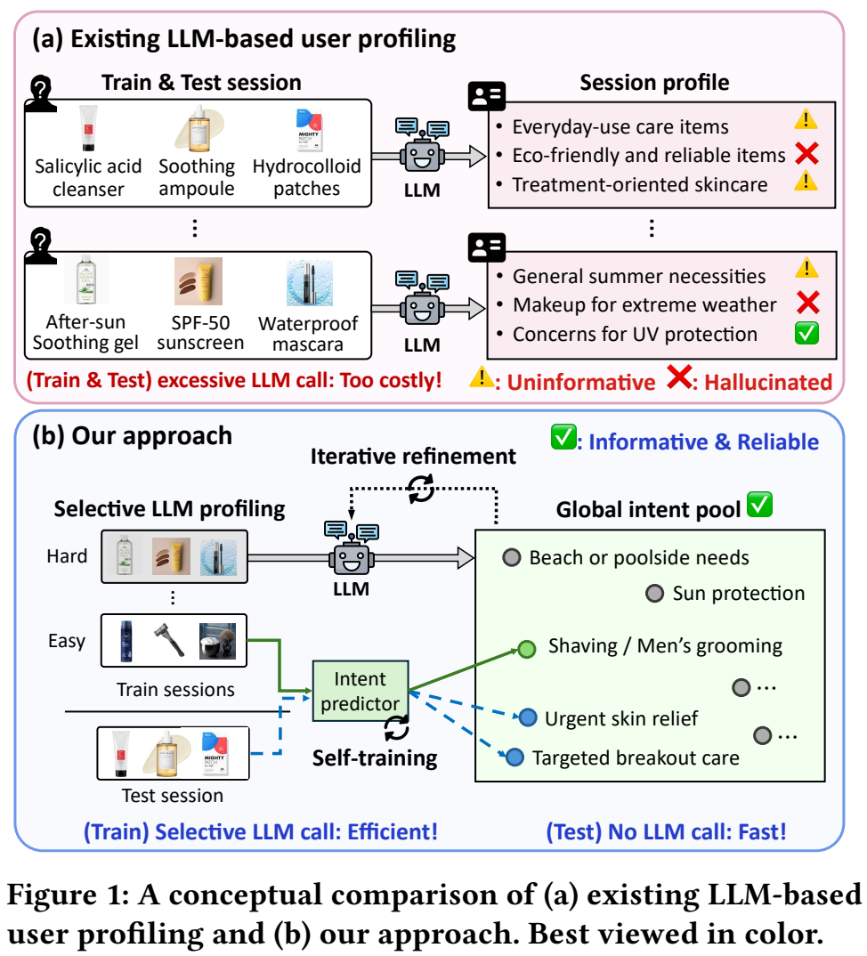
ATAI
Advanced Technique of Artificial Intelligence
ATAI
ChongqingUniversity _{AdvancedTechniqueof}
of Technology Artificial Intelligence
Chongqing University of
Technology
Chongqing University ^{ATAI}
_{of Technology} Advanced Techniqueof
Artificial Intelligence
Chongqing University of Technology
Chongqing University of Technology
Motivation
(1) Short and anonymous sessions provide limited context for LLM-based intent profiling, often leading to uninformative descriptions or hallucinations.
(2) Generating profiles independently for massive numbers of sessions incurs excessive LLM calls during both training and inference, limiting scalability.
Notes:
Source: SPRINT: Scalable and Predictive Intent Refinement for LLM-Enhanced Session-based Recommendation. SIGIR 2026. DOI: 10.1145/3805712.3809756. Figure 1, p. 1.

Slide 3
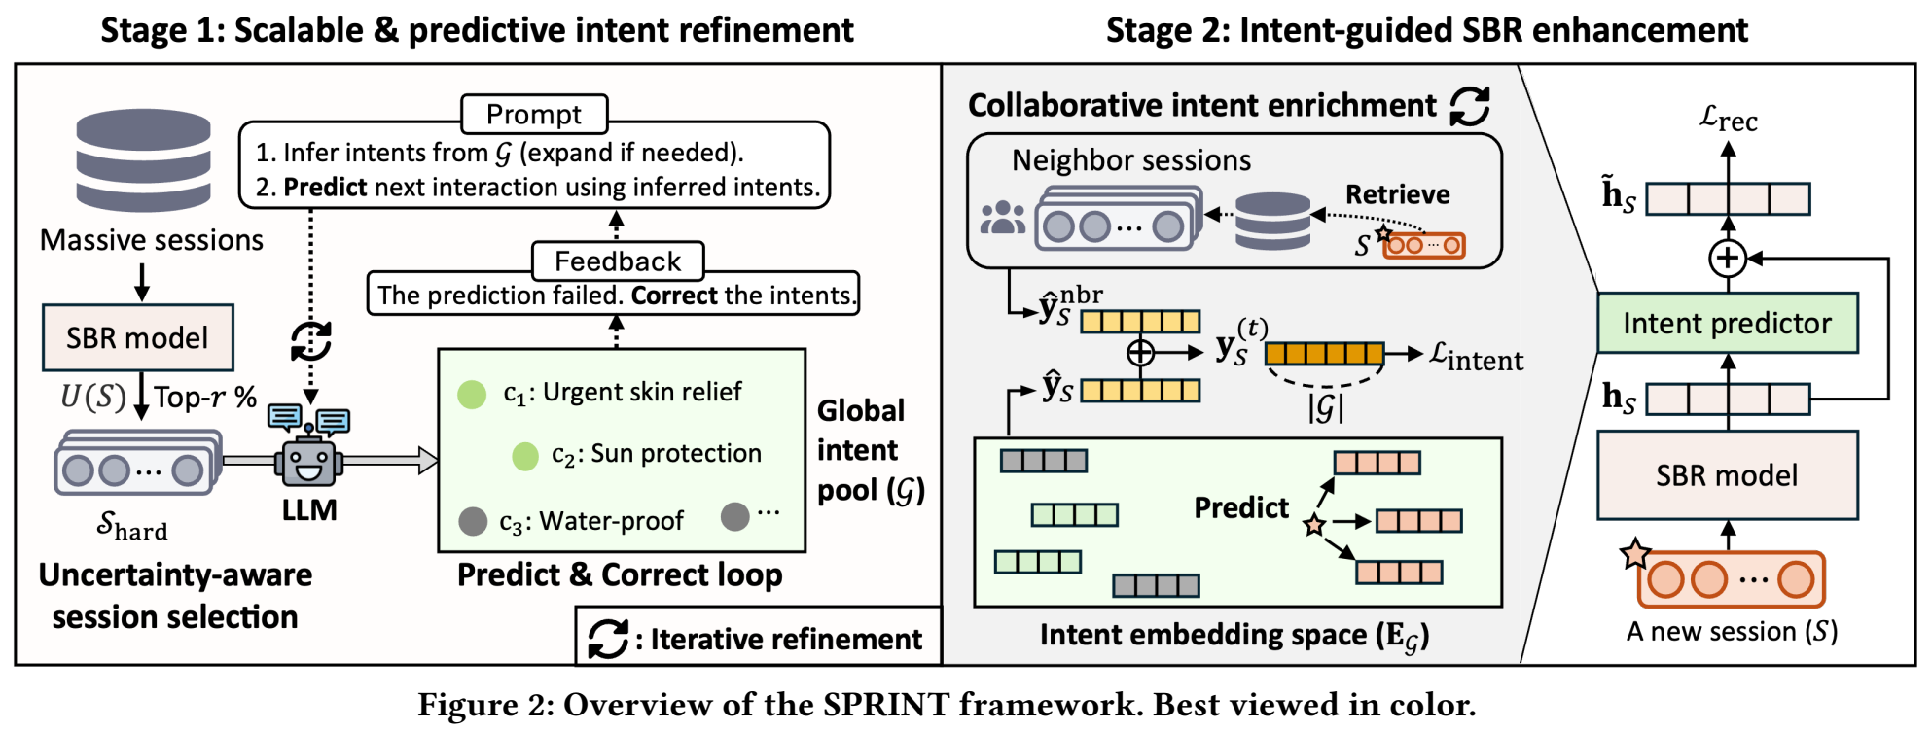
ATAI
Advanced Technique of Artificial Intelligence
ATAI
ChongqingUniversity _{AdvancedTechniqueof}
of Technology Artificial Intelligence
Chongqing University of
Technology
Chongqing University ^{ATAI}
_{of Technology} Advanced Techniqueof
Artificial Intelligence
Chongqing University of Technology
Chongqing University of Technology
Method
Notes:
Source: SPRINT: Scalable and Predictive Intent Refinement for LLM-Enhanced Session-based Recommendation. SIGIR 2026. DOI: 10.1145/3805712.3809756. Figure 2, p. 4.

Slide 4
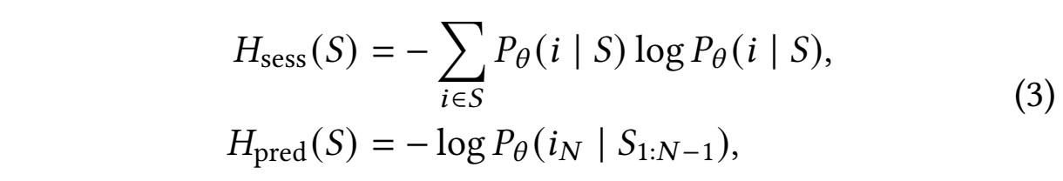
ATAI
Advanced Technique of Artificial Intelligence
ATAI
ChongqingUniversity _{AdvancedTechniqueof}
of Technology Artificial Intelligence
Chongqing University of
Technology
Chongqing University ^{ATAI}
_{of Technology} Advanced Techniqueof
Artificial Intelligence
Chongqing University of Technology
Chongqing University of Technology
Method
Notes:
Source: SPRINT, SIGIR 2026, DOI: 10.1145/3805712.3809756. Equations (1), (2), (3). Original equation numbering and notation are preserved.

Slide 5

ATAI
Advanced Technique of Artificial Intelligence
ATAI
ChongqingUniversity _{AdvancedTechniqueof}
of Technology Artificial Intelligence
Chongqing University of
Technology
Chongqing University ^{ATAI}
_{of Technology} Advanced Techniqueof
Artificial Intelligence
Chongqing University of Technology
Chongqing University of Technology
Method
Notes:
Source: SPRINT, SIGIR 2026, DOI: 10.1145/3805712.3809756. Equations (4), (5), (6), (7). Original equation numbering and notation are preserved.

Slide 6
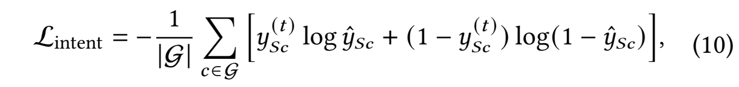

ATAI
Advanced Technique of Artificial Intelligence
ATAI
ChongqingUniversity _{AdvancedTechniqueof}
of Technology Artificial Intelligence
Chongqing University of
Technology
Chongqing University ^{ATAI}
_{of Technology} Advanced Techniqueof
Artificial Intelligence
Chongqing University of Technology
Chongqing University of Technology
Method
Notes:
Source: SPRINT, SIGIR 2026, DOI: 10.1145/3805712.3809756. Equations (8), (9), (10), (11). Original equation numbering and notation are preserved.

Slide 7

ATAI
Advanced Technique of Artificial Intelligence
ATAI
ChongqingUniversity _{AdvancedTechniqueof}
of Technology Artificial Intelligence
Chongqing University of
Technology
Chongqing University ^{ATAI}
_{of Technology} Advanced Techniqueof
Artificial Intelligence
Chongqing University of Technology
Chongqing University of Technology
Method
Notes:
Source: SPRINT, SIGIR 2026, DOI: 10.1145/3805712.3809756. Equations (12), (13), (14). Original equation numbering and notation are preserved.

Slide 8

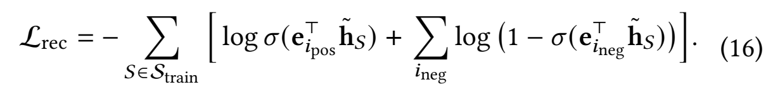
ATAI
Advanced Technique of Artificial Intelligence
ATAI
ChongqingUniversity _{AdvancedTechniqueof}
of Technology Artificial Intelligence
Chongqing University of
Technology
Chongqing University ^{ATAI}
_{of Technology} Advanced Techniqueof
Artificial Intelligence
Chongqing University of Technology
Chongqing University of Technology
Method
Notes:
Source: SPRINT, SIGIR 2026, DOI: 10.1145/3805712.3809756. Equations (15), (16), (17). Original equation numbering and notation are preserved.

Slide 9
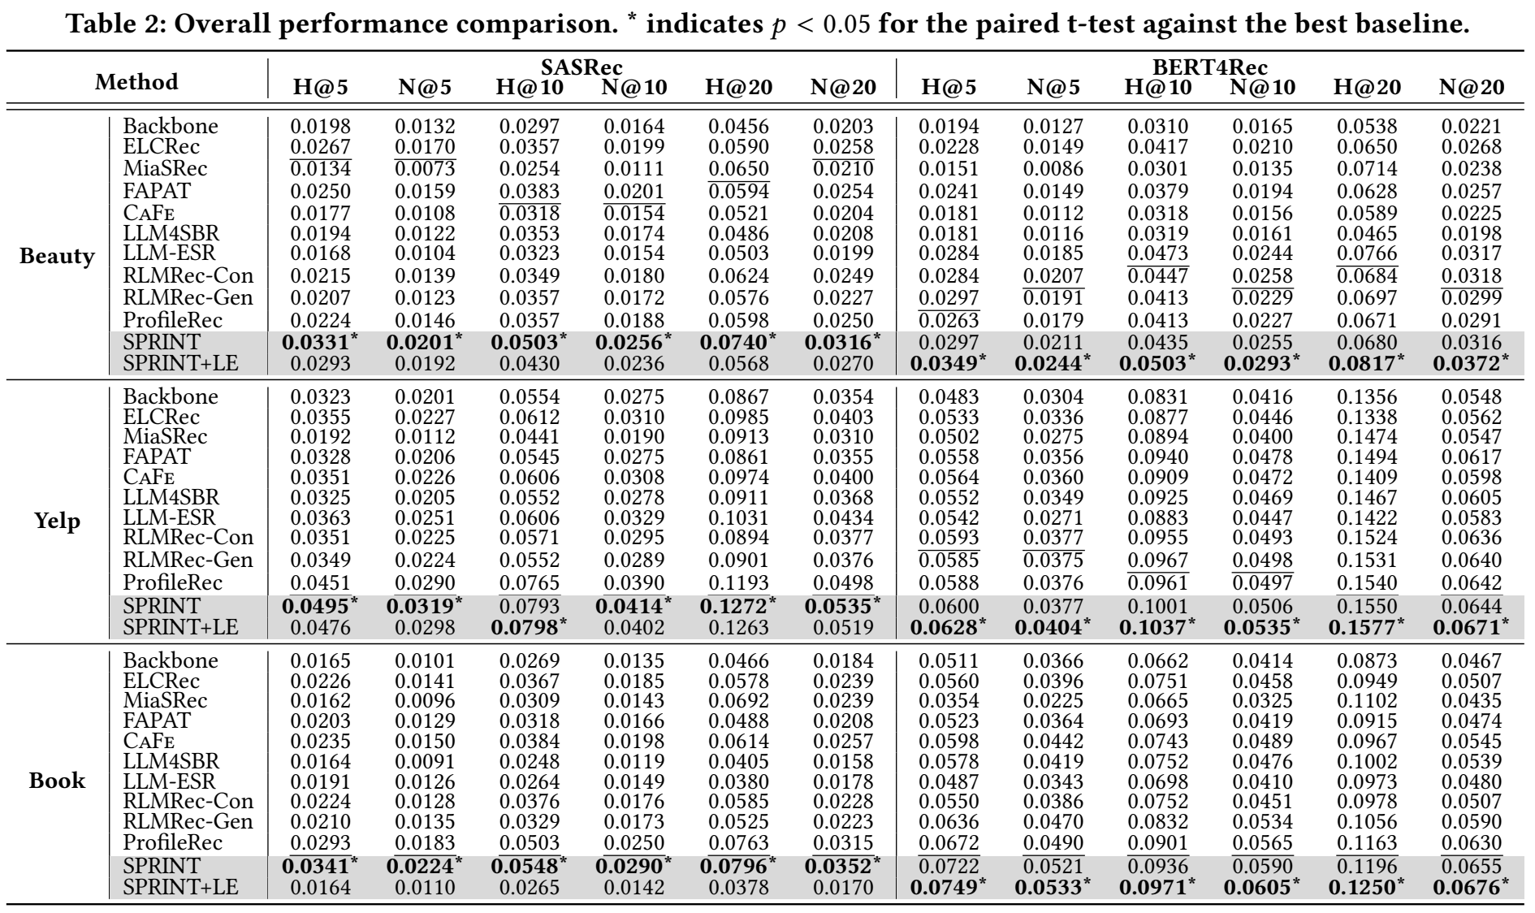
ATAI
Advanced Technique of Artificial Intelligence
ATAI
ChongqingUniversity _{AdvancedTechniqueof}
of Technology Artificial Intelligence
Chongqing University of
Technology
Chongqing University ^{ATAI}
_{of Technology} Advanced Techniqueof
Artificial Intelligence
Chongqing University of Technology
Chongqing University of Technology
Experiments
Notes:
Source: SPRINT: Scalable and Predictive Intent Refinement for LLM-Enhanced Session-based Recommendation. SIGIR 2026. DOI: 10.1145/3805712.3809756. Table 2, p. 7.

Slide 10
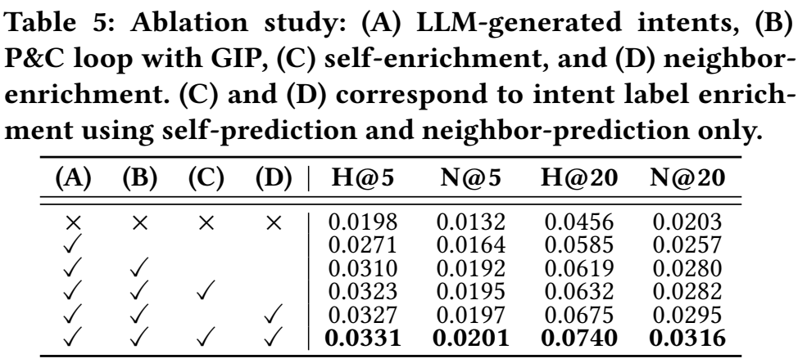
ATAI
Advanced Technique of Artificial Intelligence
ATAI
ChongqingUniversity _{AdvancedTechniqueof}
of Technology Artificial Intelligence
Chongqing University of
Technology
Chongqing University ^{ATAI}
_{of Technology} Advanced Techniqueof
Artificial Intelligence
Chongqing University of Technology
Chongqing University of Technology
Experiments
Notes:
Source: SPRINT: Scalable and Predictive Intent Refinement for LLM-Enhanced Session-based Recommendation. SIGIR 2026. DOI: 10.1145/3805712.3809756. Table 5, p. 9.

Slide 11
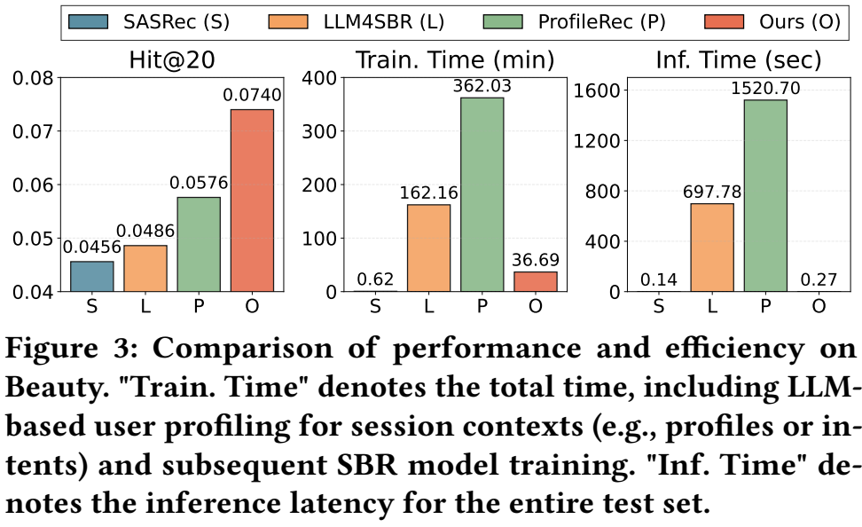
ATAI
Advanced Technique of Artificial Intelligence
ATAI
ChongqingUniversity _{AdvancedTechniqueof}
of Technology Artificial Intelligence
Chongqing University of
Technology
Chongqing University ^{ATAI}
_{of Technology} Advanced Techniqueof
Artificial Intelligence
Chongqing University of Technology
Chongqing University of Technology
Experiments
Notes:
Source: SPRINT: Scalable and Predictive Intent Refinement for LLM-Enhanced Session-based Recommendation. SIGIR 2026. DOI: 10.1145/3805712.3809756. Figure 3, p. 8. Training time includes LLM profiling and model training. Inference time is the total for the test set.

Slide 12
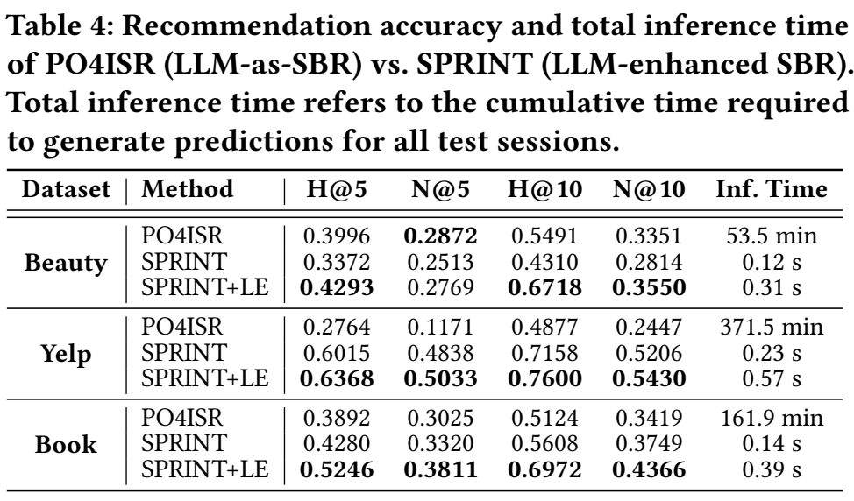
ATAI
Advanced Technique of Artificial Intelligence
ATAI
ChongqingUniversity _{AdvancedTechniqueof}
of Technology Artificial Intelligence
Chongqing University of
Technology
Chongqing University ^{ATAI}
_{of Technology} Advanced Techniqueof
Artificial Intelligence
Chongqing University of Technology
Chongqing University of Technology
Experiments
Notes:
Source: SPRINT: Scalable and Predictive Intent Refinement for LLM-Enhanced Session-based Recommendation. SIGIR 2026. DOI: 10.1145/3805712.3809756. Table 4, p. 8. Evaluation uses 20 candidates and is separate from Table 2.

Slide 13
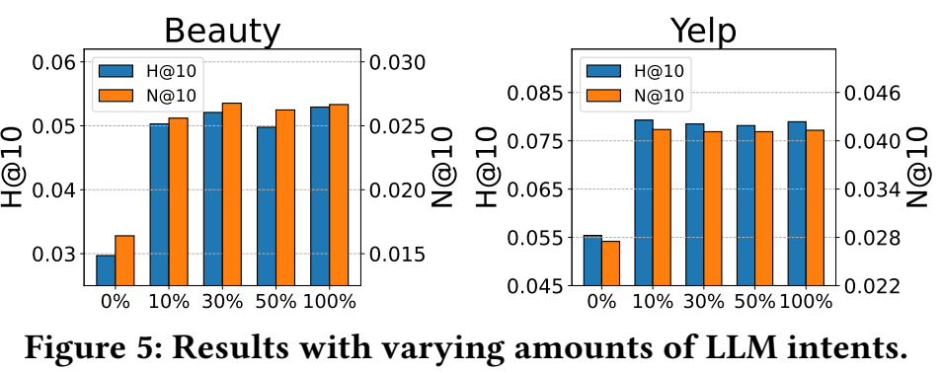
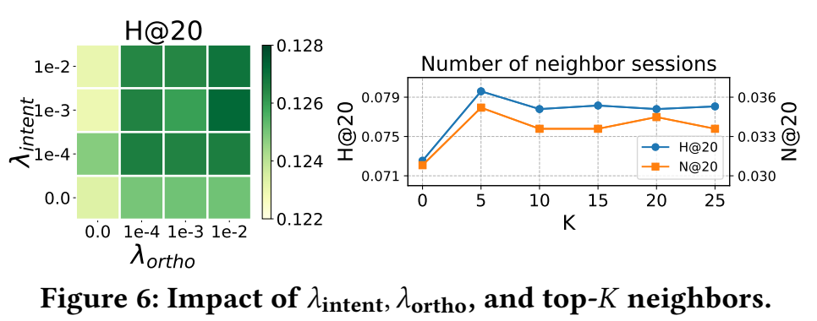
ATAI
Advanced Technique of Artificial Intelligence
ATAI
ChongqingUniversity _{AdvancedTechniqueof}
of Technology Artificial Intelligence
Chongqing University of
Technology
Chongqing University ^{ATAI}
_{of Technology} Advanced Techniqueof
Artificial Intelligence
Chongqing University of Technology
Chongqing University of Technology
Experiments
Notes:
Source: SPRINT: Scalable and Predictive Intent Refinement for LLM-Enhanced Session-based Recommendation. SIGIR 2026. DOI: 10.1145/3805712.3809756. Figures 5 and 6, p. 9.

Slide 14
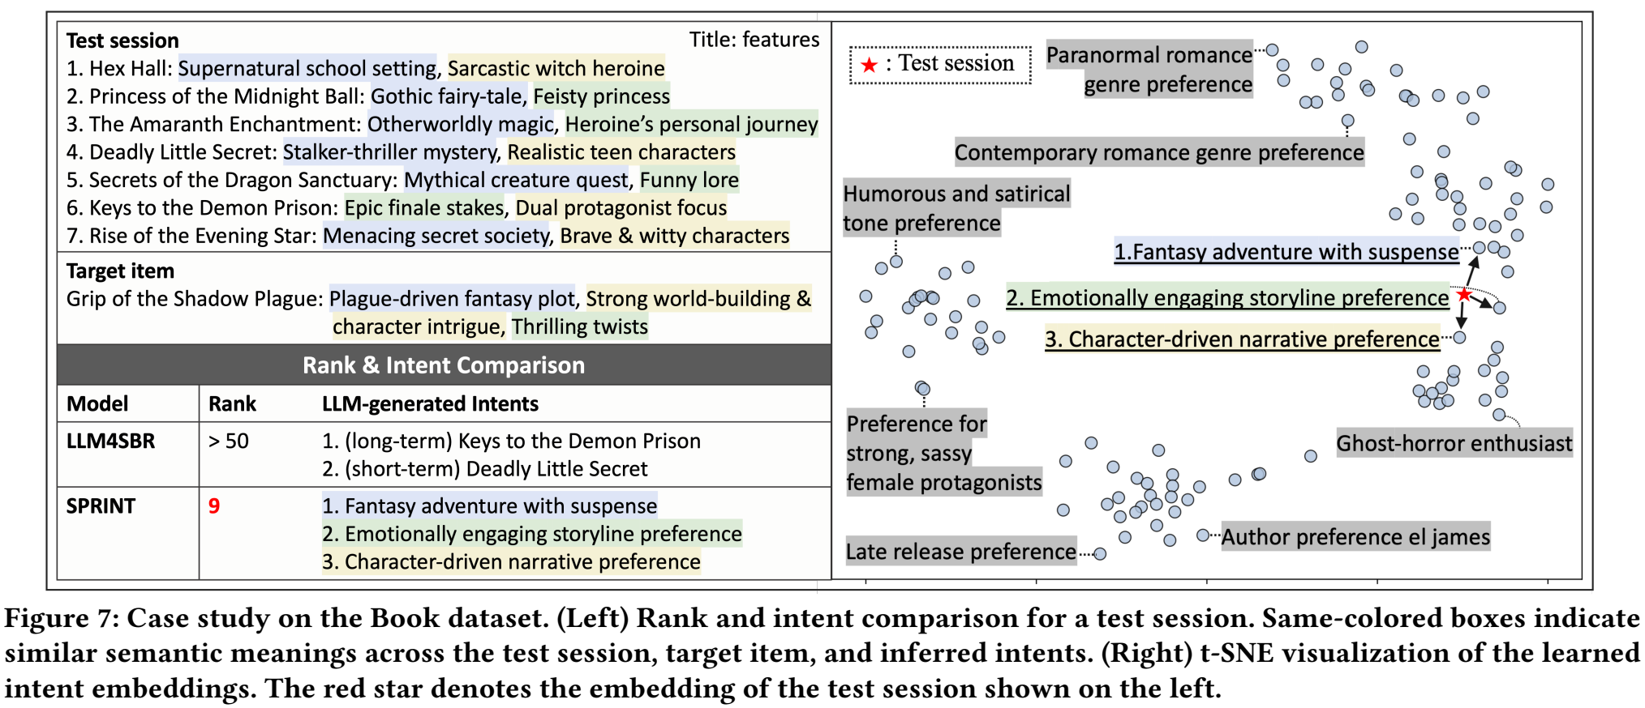
ATAI
Advanced Technique of Artificial Intelligence
ATAI
ChongqingUniversity _{AdvancedTechniqueof}
of Technology Artificial Intelligence
Chongqing University of
Technology
Chongqing University ^{ATAI}
_{of Technology} Advanced Techniqueof
Artificial Intelligence
Chongqing University of Technology
Chongqing University of Technology
Experiments
Notes:
Source: SPRINT: Scalable and Predictive Intent Refinement for LLM-Enhanced Session-based Recommendation. SIGIR 2026. DOI: 10.1145/3805712.3809756. Figure 7, p. 10.

Slide 15


ATAI
Advanced Technique of Artificial Intelligence
ATAI
ChongqingUniversity _{AdvancedTechniqueof}
of Technology Artificial Intelligence
Chongqing University of
Technology
Chongqing University ^{ATAI}
_{of Technology} Advanced Techniqueof
Artificial Intelligence
Chongqing University of Technology
Chongqing University of Technology
Thanks!

